Slide 1
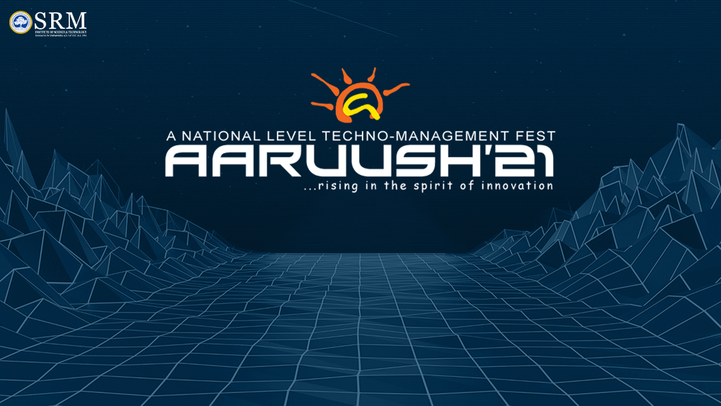

Slide 2
LEVERAGING AI/ML FOR PLASTIC MARINE DEBRIS
THIS PROJECT IS TO SAVE OUR MARINE SYSTEM AND THE NATURAL ORGANISMS DEPENDING ON THEM
PURE NATURE CURES EVERYTHING

Slide 3
INDEX:
*BUILD A DRONE
*MAIN FUNCTIONS OF THE DRONE
*DEVELOPING AN APP THAT ACCESS THE DRONE
*FEATURES OF THE APP
TEAM NAME: UKR Girls
*RAKSHITHA P || 2020-24|| SRI SAI RAM ENGINEERING COLLEGE
*KEERTHANA K || 2021-24|| SRI SAI RAM ENGINEERING COLLEGE
*UTHRA R || 2021-24|| SRI SAI RAM ENGINEERING COLLEGE

Slide 4
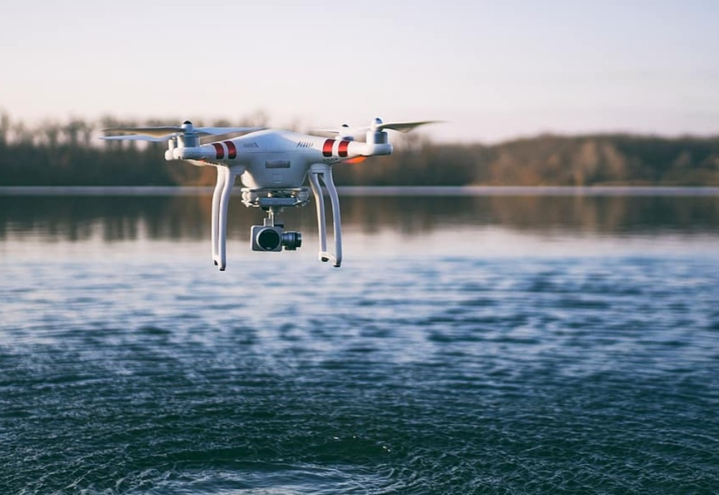
PROBLEM STATEMENT:
Leveraging AI/ML for plastic marine debris
*OUR IDEA FOR THE GIVEN PROBLEM STATEMENT IS TO BUIL A DRONE AND AN APP THAT ACCESS THE DRONE.
*THIS IDEA HELPS US TO PREVENT THE MARINE POLLUTION AND OVER COME THE PROBLEMS.
*THIS IDEA HELPS US TO FIND THE REASON FOR THE MARINE DEBRIS AND PROBLEMS TO THE ORGANISMS DEPENDENT ON IT AND ALSO PROVIDES THE SOLUTION FOR THE PROBLEM.

Slide 5
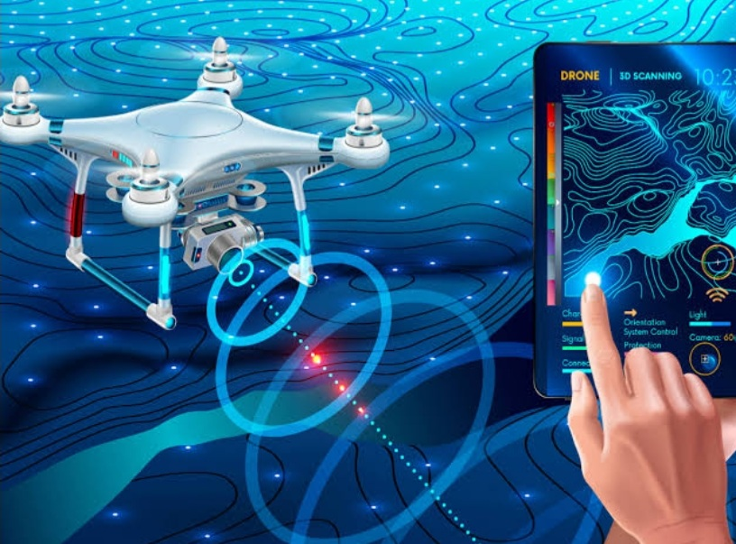
How is our project different??
BUILD A DRONE:
*First we are going to build a drone.
* It is like the regular but has different features which can help us in a major way.
MAIN FUNCTIONS OF THE DRONE:
● We are going to insert a scanner in this drone.
● The scanner which is inserted scans the water bodies and check the marine polluted percentage, what type of materials are there in the marine which pollutes it, how much amount of polluting materials like plastics and other inorganic materials are in the marine, which type of material is highly hazardous and also the ages of those materials so that we can identify what were all the problems caused because of the duration of it being there.

Slide 6
DEVELOPING AN APP:
●We plan to develop an app which helps us to access the drone and control its system.
●It recognises every single thing which is scanned by the drone and displays it to us.
FEATURES OF THE APP:
●This app as it can access the drone will identify and display the pollution percentage, type and amount of the hazardous material, highly hazardous material and also the duration or age of that materials.
●This app identifies the problems and displays us the solution to prevent the problems and also provides us with the solution to remove those hazardous materials.

Slide 7
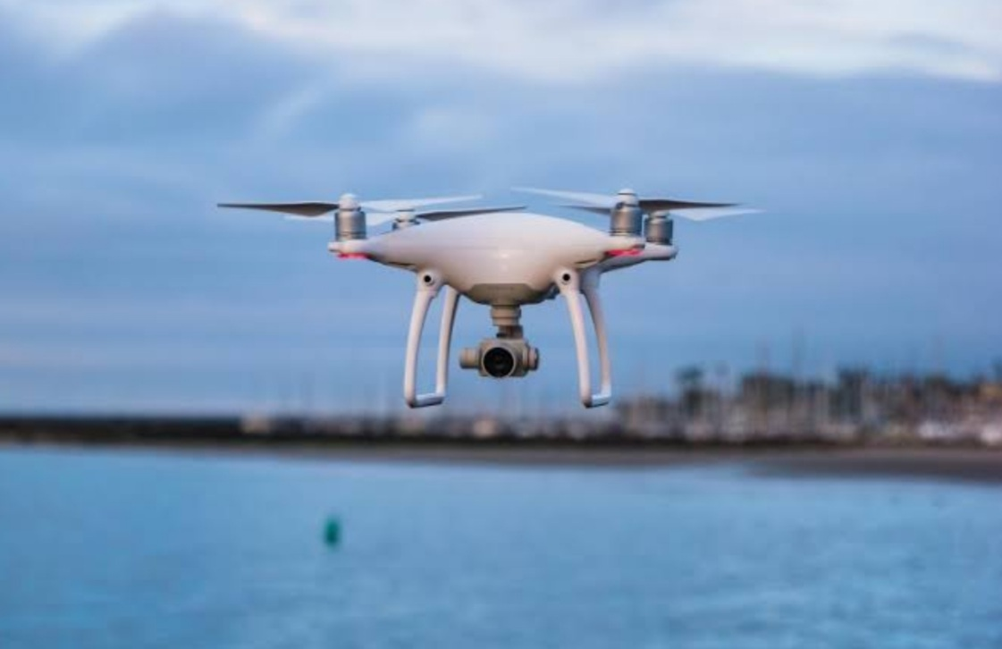
This drone also has an laser and a sensor which helps us to identify the water quality index, water purity and also the water level of the water body by finding it’s depth using the laser.
BY MAKING THIS IDEA POSSIBLE WE CAN CREATE A POLLUTION FREE ENVIRONMENT

